Slide 1
Receiver Data Source Configuration
Module 4

Slide 2
Module Objectives
Upon completion of this module, you will be able to:
Access and Configure McAfee Receiver Data Sources
Configure and Customize ESM Data Source Profiles
Configure the McAfee Receiver to auto learn data sources
Access and Configure Vulnerability Assessment Data Sources

Slide 3

Module Topics
Receiver Data Sources
Client Data Sources
Child Data Sources
Data Source Profiles
Auto Learn Data Sources
Configuring Common Data Sources

Slide 4
Receiver Data Sources
Receiver Data Source Settings are used to control how event and log data is collected by the Receiver
Common formats for data sources include
Syslog (both UDP and TCP)
WMI
SNMP
Snare or the McAfee Agent for Windows logs
MEF – McAfee Event Formats for custom log settings
Netflow (generic Netflow, sFlow)
McAfee currently supports over 250 different data sources
Notes:
McAfee currently supports over 250 different data sources. The list can be found at http://www.mcafee.com/us/resources/data-sheets/ds-siem-device-support-matrix.pdf this list is updated on a weekly basis. Any device on this list is considered supported, and as such any problems with integrating the data source into McAfee will be fully supported by our support team. Certain configuration standards may have to be met in order to ensure compatibility.
Devices not on the list can be submitted to McAfee via the support portal, and can be added to the supported device list based on several factors.

Slide 5
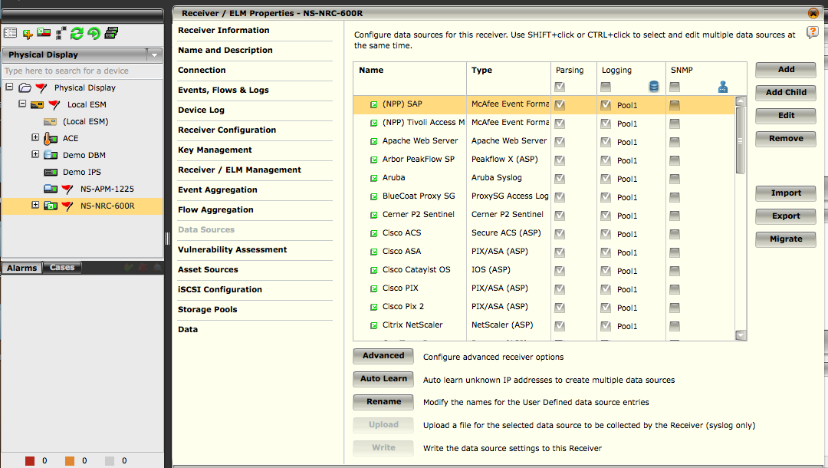
Receiver Properties – Add Data Source
2
Select the receiver you are applying the data source setting to.
Select the Receiver properties.
From the Receiver Properties listing, select ‘Data Sources’
1
3
Notes:
The McAfee ESMI desktop makes accessing data source settings extremely easy and efficient.

Slide 6
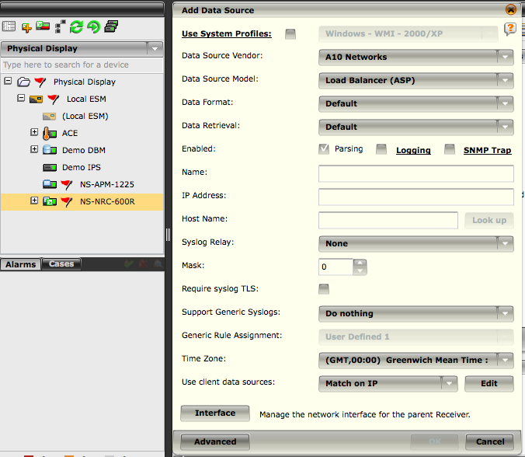
System Navigation – Add Data Source
2
Select the receiver you are applying the data source setting to.
After selecting the Receiver, select the Add Data Source icon.
1
Notes:
The System Navigation shortcut will show the add Data Source menu, but will not show the existing listing, or options to edit existing sources.

Slide 7
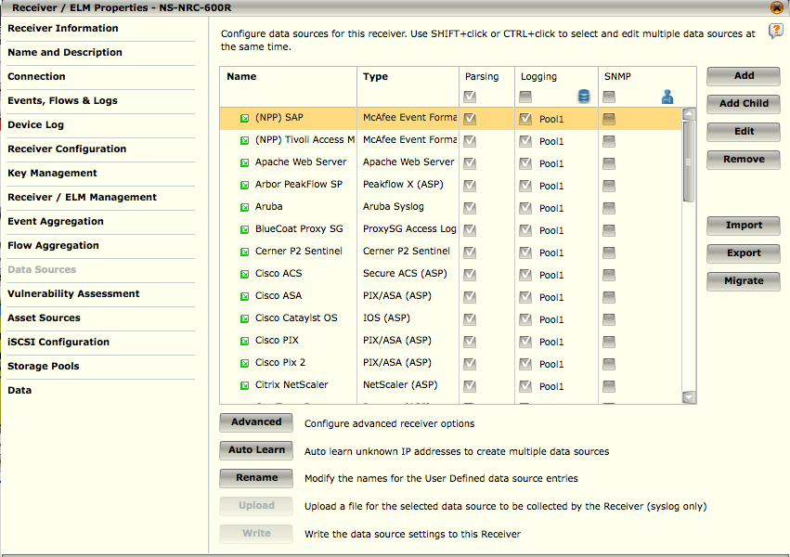
Data Sources Screen
The Data Sources screen is the starting point for configuring the settings for all data sources
You can add, add a child, edit, and remove data sources from this screen along with defining many other specific configuration settings
It indicates whether or not Parsing, Logging, and SNMP Trap are enabled and allows you to change the settings for these options for each data source
Notes:
Add – Shows the dialogue for Add Data Source
Add Child – Allows you to add a child data source, to one of the parent data sources. This will be covered in the advanced topics section.
Edit – This option allows you to edit the properties for an existing data source.
Remove – This option allows you to remove an existing data source from the configuration.
Import / Export – This options allows you to either import data sources from a properly formatted file, or export the existing data source parameters. Again, this topic, including the proper import formatting will be covered in the advanced section.
Auto Learn – Allows the system to learn unknown IP addresses with the option to add each of them as a data source. ESMI Desktop does not allow for automatic adding of data sources, due to the possibility of a rogue intruder using this to launch a DOS attack against a Receiver by spoofing packets.
Upload – This allows for a syslog file to be collected by the receiver.
Write – This options writes the current, updated data source configuration to the Receiver. Any changes made to the Data Source Settings are not utilized until they are written to a Receiver.

Slide 8
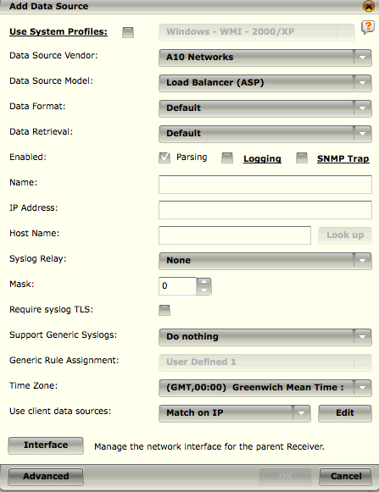
Add Data Source Settings
Once you select the option to add a data source, you are taken to the Add Data Source menu.
As you select different options, additional parameters may become available for selection and configuration
Notes:
Use System Profiles – System profiles are a way to use settings which are repetitive in nature, without having to enter the information each time. An example is WMI credentials, which are necessary to retrieve Windows Event Logs if WMI is the chosen mechanism. Often times these credentials are the same for a large number of servers. Creating a System Profile saves time and if they need to be updated in the future, only a single update needs to take place.
Data Source Vendor – This is the vendor of the data source, such as AirDefense, or Cisco.
Data Source Model – This varies by vendor, and is akin to the product name such as vendor: Cisco, and Data Source Model could then be Catalyst OS, PIX/ASA, or TACAS+.
Data Format - Again, this will vary based on the combination of Data Source Vendor / Model. An explanation of each of the types will be found throughout the training materials. The default option is the most commonly used, or best option for parsing the events.
Data Retrieval – This dictates the way the data is retrieved from the data source. Options include default (usually syslog), or retrieving files via SCP, HTTPS, or some other mechanism.
Enabled - Parsing/SNMP Trap – Enables Parsing of the data source, and SNMP traps received from the data source. If neither option is checked, the settings are saved to the ESM, but not written to the Receiver or utilized.
Name – This is the name that will appear in the Logical Device Groupings (tree) and the filter lists.
IP Address / Hostname – The IP Address and Host Name associated with the data source.
Time Zone - If the data source sent with the Time Zone is set to the devices local time zone, you need to set the time zone of the data source so it can be set accordingly. If you see errors saying events are being discarded because the Last Time value is more than one hour in the future, or the values are incorrect, you may need to adjust this setting.
Client Data Sources – Allows you to associate clients with this data source. The clients will share the same policy and rights as the parent data source. For example, when using an ePO Server as a data source, any client sources reporting events back to ePO would be considered child data sources, such as McAfee Agent, Host Intrusion Prevention, VirusScan, etc.
Interface – Opens the receiver interface settings to associate ports with streams of information.
Advanced – Opens Advanced Settings for the Data Source.

Slide 9
Client Data Sources
Client Data Sources enable you to extend the maximum allowed number of data sources (500)
Syslog, ASP, CEF, NPP, and WMI, you can add up to 255 data source clients
Properties of Client Data Sources:
Will not have VIPS, Policy, or Agent rights.
Will not be displayed on the Receiver Properties > Data Sources table.
Will appear on the System Navigation Tree.
Will share the same policy and rights as the parent data source.
Must be in the same time zone since they use the parent's configuration.
Children have the ability to set an independent time zone.
WMI is an exception because the time zone is determined by the query sent to the WMI server; therefore, Client WMI data sources can have independent time zones.

Slide 10
Match on Type vs. IP
Match on Type
Matches data based on the type of data contained in the stream.
If you have a single device that is collecting data from other devices and then forwarding to the Receiver, you might want to use Match on Type
Match on IP
Used for the same kind of devices sending the same kind of log data which on differs by the IP address of the sending device.

Slide 11
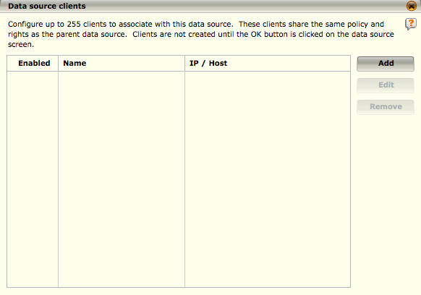
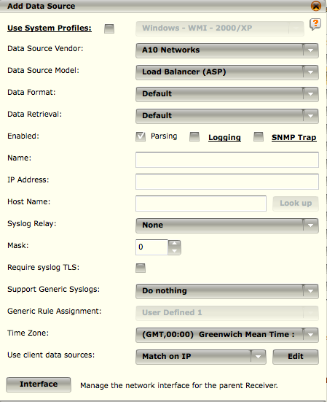
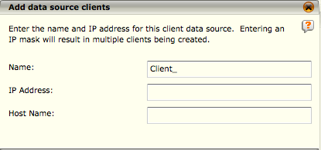
Adding a Client Data Source
2
If Match on IP is selected, enter the IP address for the client.
If Match on type is selected, select the type of data source in the Data Source Vendor and Data Source Model fields.
3
1
Notes:
To configure a client data source, Access the Add Data Source screen (Receiver Properties > Data Sources > Add) and do the following:
Click on the Edit button. The Data source clients dialog will open. If you are editing a data source that has existing clients, those clients will be listed on this screen.
Click on Add to add a new client. The Add data source clients dialog will open.
Add a name for this client in the Name field.
If Match on IP is selected, enter the IP address for the client. If Match on type is selected, select the type of data source in the Data Source Vendor and Data Source Model fields.
The client you added will appear on the Data source clients table. Keep in mind, however, that it will not be added to the system until OK has been clicked on the Add or Edit Data Source dialog.

Slide 12
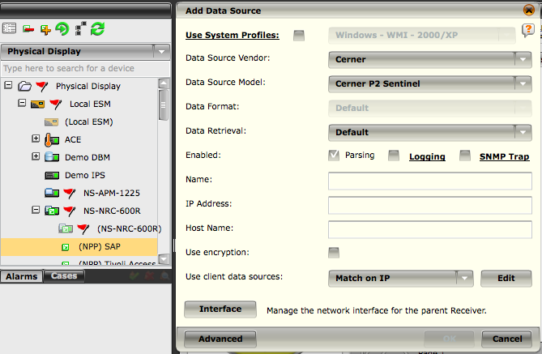
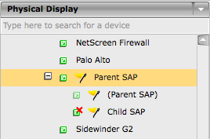
Adding a Child Data Source
2
NOTE
Child data sources count against the maximum number of data sources allowed for your Receiver
1
Notes:
Once you have added a data source, you can add child data sources. This is particularly useful when you would like to organize your data sources.
To do so:
1. Highlight the data source to which you would like to add children on the Data Sources table (Receiver > Properties > Data Sources).
2. Click on the Add Child button. The Add Data Source dialog will open.
3. Fill out the fields as you would for a parent data source (refer to the Add a Data Source section).

Slide 13
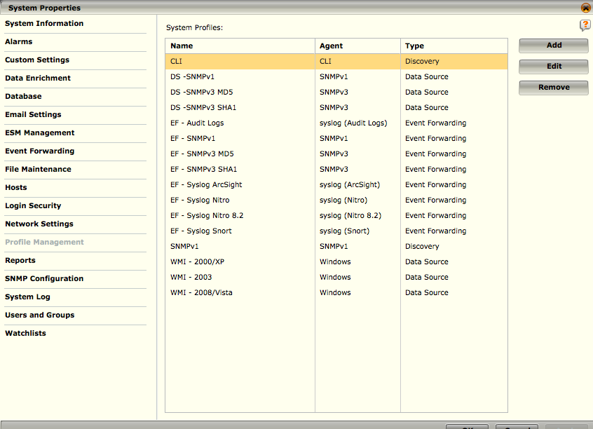
Data Source Profiles
Profiles can be set for Data Source, Event Forwarding, Network Discovery, SNMP Trap, Vulnerability Assessments, and Remote Share
Notes:
Profile Management provides the ability to configure settings for traffic that can be reused in Event Forwarding and Data Source configuration. By using System Profiles, it is possible to perform setups that share common information without having to enter the details each time.

Slide 14
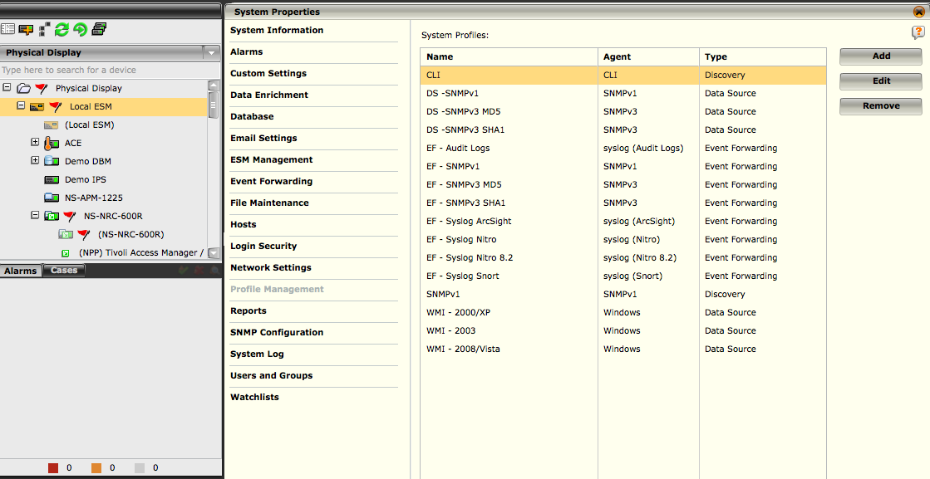
Data Source Profiles
2
System Profiles are accessed through the ESM Settings and selecting Profile Management.
You can add a new profile, edit an existing profile, or remove an existing one.
Profiles can be set for Data Source, Event Forwarding, Network Discovery, SNMP Trap, Vulnerability Assessment, and Remote Share.
1
3
Notes:
System Profiles are accessed through the ESM Settings and selecting Profile Management. This will bring up a list of existing system profiles. Once you have this list, you can add a new profile, edit an existing profile, or remove an existing one.
Select the ESM from the system navigation tree.
Select the ESM properties shortcut icon from the navigation bar.
Select the Profile Management Tab to display the System Profiles configuration screen.

Slide 15
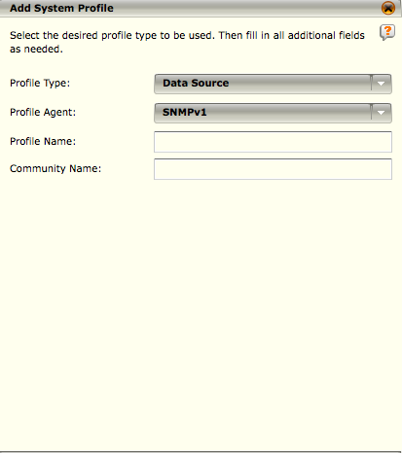
Data Source Profiles - SNMP
For an SNMP Profile you will need to enter the agent type, profile name, and the community name
If SNMP v3 is selected, authentication information will need to be entered as appropriate.
1
2
Notes:
To add a System Profile for a Data Source, complete the following steps:
1. Profile Type: Select Data Source
2. Profile Agent: Select an SNMP data source.

Slide 16
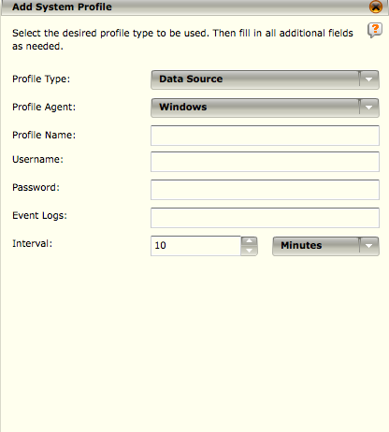
Data Source Profiles - Windows
Windows Profile:
Profile Name: Enter a name used to refer to and select the profile
Username: The username used to access the windows logs for this server group.
Password: Password which corresponds to the username.
Event Logs: Enter the names of the windows logs you wish to collect. Common values are SYSTEM, APPLICATION and SECURITY.
Interval: Duration at which the server using this profile will be polled by the WMI collection mechanism.
1
2
Notes:
To add a System Profile for a Data Source, complete the following steps:
1. Profile Type: Select Data Source
2. Profile Agent: Select Windows data source.

Slide 17
Data Source Types
There are several data source types, each of which have unique capabilities and usage
Advanced Syslog Parser (ASP)
Provides a mechanism for parsing data out of syslog messages based on user defined rules
McAfee Event Format (MEF)
Provides a structure for external programs to insert events in the most efficient manor
ArcSight Common Event Format (CEF)
Allows parsing of events that are formatted in CEF
Windows Management Instrumentation (WMI)
Provides support for the infrastructure for management data and operations on Windows-based operating systems
Notes:
ASP is the Advanced Syslog Parser. It provides a mechanism for parsing data out of syslog messages based on user-defined rules. The Rules instruct the Advance Syslog Parser on how to recognize a given message and where in that message specific event data resides such as Signature IDs, IP addresses, ports, usernames, actions, etc. The Advanced Syslog Parser can be utilized for syslog devices that are not specifically identified in the Add Data Source dialog or when the Source Specific Parser does not correctly interpret messages or fully interpret data points related to received events. The Advanced Syslog Parser is also ideal for sorting through complex log sources such as Linux and UNIX servers. You can also create custom parsing rules for data sources not supported by default.
MEF – McAfee Event Formats for custom log settings. The purpose of MEF is to provide a means for an external program to insert events into the Receiver's database. One example is an output plug-in for Barnyard using Snort's unified (fast) output.
CEF – CEF is the ArcSight Common Event Format. Using this format allows for parsing of events that are in this format already either by the device or an ArcSight event being sent to the McAfee SIEM.
WMI – WMI is the Microsoft implementation of Web-Based Enterprise Management (WBEM) as defined by the Distributed Management Task Force (DMTF). It is the primary management technology for Windows operating systems, permitting management information to be shared between management applications. The ability to obtain management data from remote computers is what makes WMI useful. WMI event logs are setup as a data source and sent through the Receiver. The Receiver polls the Windows server on a set interval and collects the events. The WMI collector can collect events from any event log on the windows box. By default, the Receiver will collect security, administration and event logs. You have the ability to enter other log files, such as Directory Service, Exchange, etc. The event log data gets collected in the packet data and can be viewed through the event table details.

Slide 18
Data Source Specific Settings
Several Data Sources will have additional settings which will show based on the Device Vendor and Device Model Settings, including:
Syslog or CEF Protocol
Check Point (OPSEC Protocol)
Cisco IDS (4.x+ protocol)
ISS
Microsoft WMI Event Log
Netflow
McAfee SNMP
SDEE
Notes:
Syslog or CEF protocol - The syslog relay and Host Name fields will be available. Select syslog-ng if this data source is listening for a syslog-ng server that is forwarding events from devices that it may be monitoring to the Receiver. Only enter a host name if the syslog-ng server is forwarding events using the host name rather than the IP address. If you click on the Lookup button, a DNS lookup will be performed to get the host name from the IP address used for the data source. For details regarding setting up the data sources required to receive this data, refer to Separating Data Received Via Syslog-NG section.
Check Point (OPSEC Protocol) - The Device Type, Port, Use Authentication, Application Name, Activation Key, and Use Encryption fields are available for additional
configuration.
Cisco > Cisco IDS (4.x + protocol) - Add the Username and Password for the device, and select how often you want to query the device for events in the Interval field.
ISS - Add the Username, Password, and Interval.
Microsoft > WMI Event Log - Fill in the NetBIOS Name, Username, Password, Event Logs, Interval, and Version. When entering additional event log names, keep in mind that they are case sensitive, must be separated by a comma, and shouldn’t have spaces between them. Administrative or backup operator privileges are required for WMI event logs.
Continued on next page

Slide 19
Hidden
Notes:
Netflow - Select the Port and click on Enable Forwarding if desired. Add the Forwarding IP Address and Forwarding Port. Enabling forwarding is useful if you wish to forward your event data to a syslog or SNMP sever. To enable forwarding, check the Enable Forwarding checkbox provided. Then enter the forwarding IP address and forwarding port in the field provided.
McAfee SNMP - Select Authentication Mode and Require SNMP v3 if desired. In the Generic Rule Assignment field, choose the location where the auto learned rules triggered from the data source are going to be saved. Add Community, Username, and Password.
SDEE - Select Port, Interval, and whether or not to use SSL I Proxy. Add URI, Username, Password, Proxy IP Address, Proxy Port, Proxy Username, and Proxy Password. If the connection times out, you may need to add the receiver as an allowed host on the Cisco device. To do so, select IPS Manager > Sensor Setup > Allowed Hosts/Network > Add Receiver and enter the IP address of the Receiver in the Add Receiver section.

Slide 20
Data Sources – Auto Learn
This feature provides the capability for the Receiver to learn data sources automatically
1
2
Notes:
The auto-learn feature provides the capability for the system to learn data sources automatically. It enables you to open the firewall on the Receiver for a designated period of time so the system can learn a set of unknown IP addresses, which you can then add to the system as data sources. Once auto-learning has been enabled, the process will occur for the period of time you specified in the settings.
Access the Data Sources screen (Receiver Properties > Data Sources).
Click on the Auto Learn button at the bottom of the Data Sources screen. The Auto Learn dialog will open.

Slide 21
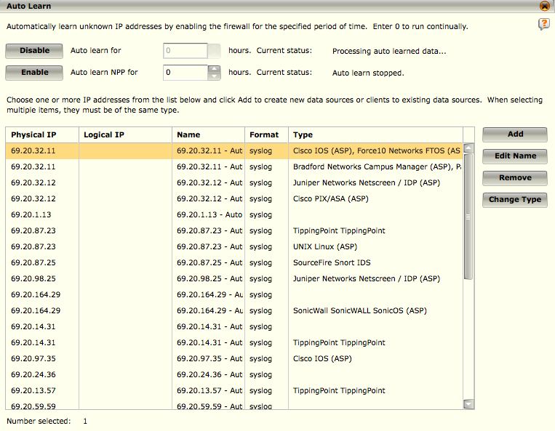
Data Sources – Auto Learn
NOTE
The default setting is 0, which means Auto Learn will run continuously
Notes:
Enable / Disable – Enable or disable the auto learn feature for desired protocol for the stated number of hours. When time expires, the auto learn table will be populated with the addresses found and the feature disabled until activated again. You can also view the list of discovered sources by disabling auto-learn at any time before the time period expired.
The IP Address table lists the addresses found through the auto-learn process.
You then select each IP address and then Add. This will bring up the add data source dialogue and fill it in as appropriate for the type of data source the address refers to. You can make changes to the settings if desired.
You can also multi-select devices and add them as individual or client data sources.
Data Sources found through auto learn must be confirmed by an administrator in order to be active within the system. If the data sources are not confirmed and set up by the administrator, they will not be processed by the receiver. This prevents malicious activity with auto-learning of data sources by individuals.

Slide 22
Configuring Common Data Sources

Slide 23
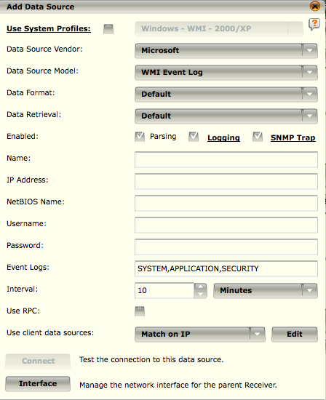
Data Sources - WMI
WMI is the Microsoft implementation of Web-Based Enterprise Management (WBEM) as defined by the Distributed Management Task Force (DMTF)
It is the primary management technology for Windows operating systems, permitting management information to be shared between management applications
The ability to obtain management data from remote computers is what makes WMI useful
Notes:
WMI event logs are setup as a data source and sent through the Receiver. The Receiver polls the Windows server on a set interval and collects the events.
The WMI collector can collect events from any event log on the windows box. By default, the Receiver will collect security, administration and event logs.
You have the ability to enter other log files, such as Directory Service, Exchange, etc. The event log data gets collected in the packet data and can be viewed through the event table details.
To this:
Go to the Add Data Source menu
Set Data Source Vendor: Microsoft
Set Data Source Model: WMI Event Log
Data Format and Retrieval leave as default
Enabled – Click on Parsing, Logging, and SNMP Trap as appropriate. This setting dictates whether or not the data will be processed, and in what manner.
Name – Descriptive name for data source, will appear in the logical grouping tree.
IP Address – IP Address of this data source device
NetBIOS Name – NetBIOS name for this windows server.
Username / Password
Event Logs – Logs data is to be retrieved from. These names are case sensitive.
Interval – Set the WMI polling interval
Use RPC – Check if RPC is to be utilized (not likely)
Client data sources can be set to match on either type or IP.
Interface – Allows for control of the interface settings on the receiver.

Slide 24
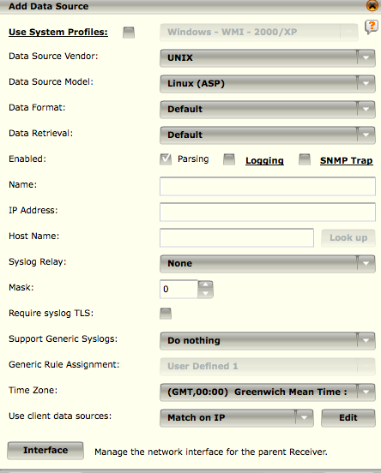
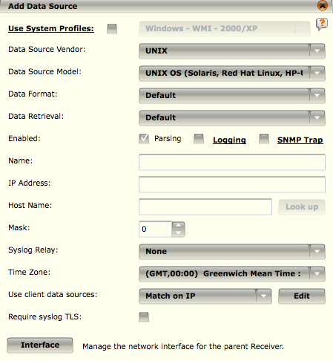
Data Sources Syslog
Syslog data may come from a variety of sources, including network gear, firewalls, and UNIX Servers
The Linux ASP parser provides a method to support generic syslog messages by creating custom rules in a Snort like format
Notes:
Data Source Vendor – UNIX
Data Source Model – UNIX OS or Linux (ASP)
Data Format / Retrieval: Default
Enable Parsing / Logging / SNMP Trap as appropriate
Name – Name for this data source which will appear in the logical grouping
IP Address – IP Address that will appear in the Logical Groupings
Hostname – Lookup or manually enter host name for this data source
Syslog Relay – If you are using syslog-ng for example, you will need to set the syslog relay.

Slide 25
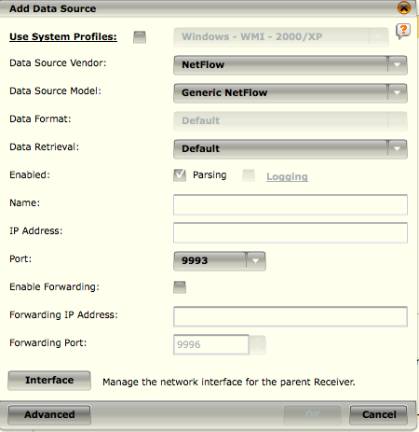
Data Sources – Generic Net Flow
Supports Versions 5, 7, and 9
Enabling forwarding is useful if you wish to forward your event data to a syslog or SNMP sever
To enable forwarding, check the Enable Forwarding checkbox provided and Add the Forwarding IP Address and Forwarding Port
Notes:
Netflow, Cisco > ASA NSEL - Select the Port and click on Enable Forwarding if desired. Add the Forwarding IP Address and Forwarding Port. Enabling forwarding is useful if you wish to forward your event data to a syslog or SNMP sever. To enable forwarding, check the Enable Forwarding checkbox provided. Then enter the forwarding IP address and forwarding port in the field provided.

Slide 26
Vulnerability Assessments Data Sources
The Vulnerability Assessment (VA) option on the Receiver Properties screen allows you to integrate data that can be retrieved from a variety of vulnerability assessment vendors.
VA data can be used for the following:
Raise an event’s severity based on knowledge of the end point’s known vulnerability to that event
Automatically learn assets and their attributes (OS and services detected)
Provide a mechanism to define Asset Filter Groups and allow you to create and manipulate the membership of user-defined Asset Groups
Provide summary and drill-down information of the network assets
Modify Policy Editor configuration (i.e., turn on MySQL signatures if an asset is discovered to be running MySQL).
Notes:
Accessing VA Features
To configure communication parameters, schedule parameters to dictate how often data should be retrieved, and modify event severity calculations, you need to access the Vulnerability Assessment screen as follows:
1. Select the Receiver that will receive the VA data on the System Navigation Tree.
2. Click on the Properties icon in the Actions Toolbar. The Receiver Properties screen will open.
3. Click on the Vulnerability Assessment option on the Receiver Properties menu. The Vulnerability Assessment screen will open listing the configured VA sources on the system.

Slide 27
Vulnerability Assessments Data Sources
Currently, McAfee can integrate with the following vendors:
eEye REM
eEye Retina
McAfee FoundStone
Critical Watch FusionVM
LanGuard
Lumension
nCircle
Nessus
NGS
OpenVAS
Qualys
Rapid7 Metasploit Pro
Rapid7 Nexpose
Saint
Notes:
The McAfee rules team maintains a rules file that maps a McAfee signature ID to a VIN to one or more references to a CVE ID, BugTraq ID,OSVDB ID, and/or Secunia ID. These vendors report CVE and BugTraq IDs in their vulnerabilities; therefore, CVE and BugTraq IDs are included in each release.

Slide 28
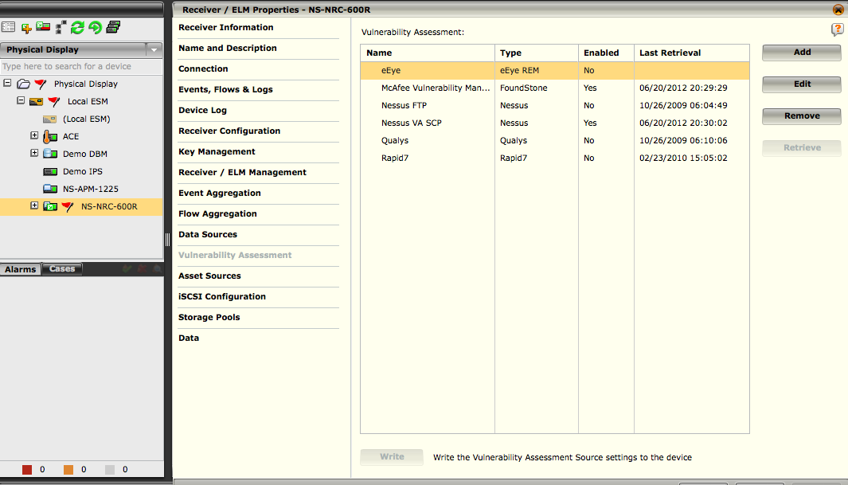
Data Sources – Vulnerability Assessments
1
The Vulnerability Assessment feature allows you to retrieve data from a variety of vulnerability assessment (VA) vendors.
In order to communicate with the desired VA sources, you will need to add the source to the system as well as edit it or remove it from the system when needed.
Once a source has been added to the system, you can retrieve the VA data.
2
Notes:
To add a VA source, do the following:
1. Access the Asset Manager screen by clicking on the Asset Manager quick launch icon ().
2. Click on the Vulnerability Assessment tab. A tree showing the Receivers on the system with their current VA sources, will open.

Slide 29
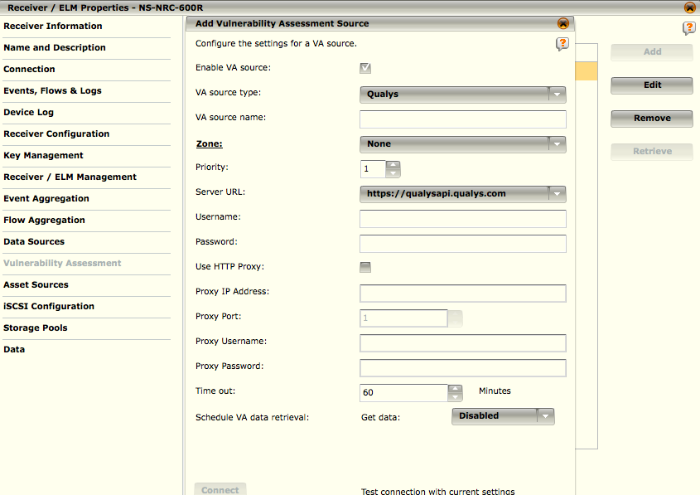
Data Sources – Add VA Source
To add a VA source, you will need to:
Configure communication parameters for the VA vendor
Schedule parameters to dictate how often data should be retrieved, and modify event severity calculations
Notes:
To configure the communication and schedule parameters, do the following:
Click on the Vulnerability Assessment option on the Receiver Properties menu. The Vulnerability Assessment screen opens.
Click on Add. The Add Vulnerability Assessment Source dialog opens.

Slide 30
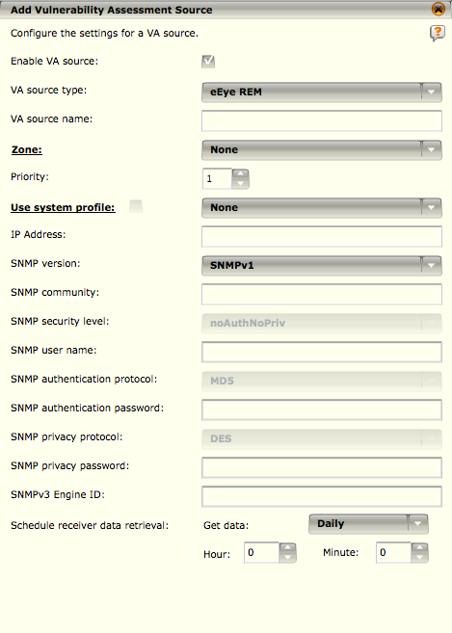
Data Sources – Enable VA
If the Enable VA Source checkbox is unselected, the configuration settings for this data source will be saved on the ESM for further use, but the settings will not go to the Receiver when applying VA source settings.
Notes:
Enable this VA source by clicking on the Enable VA Source checkbox. The enabled setting will dictate whether or not the Receiver will process data for this source.
Enable this VA source by clicking on the Enable VA Source checkbox. The enabled setting will dictate whether or not the Receiver will process data for this source. If the Enable VA
Source checkbox is unselected, the configuration settings for this data source will be saved on the ESM for further use, but the settings will not go to the Receiver when applying VA source settings.
Select the VA source type in the VA Source Type combo box. The fields on the Add System Configuration Vulnerability Assessment Source dialog will change based on the source type selected.
eEye REM - versions of REM events server = 3.7.9.1721
eEye Retina - versions of Retina = 5.13.0, Audits: 2400
Once you have entered the information, you can test the connection by clicking on the Connect button at the bottom of the dialog for Nessus, Qualys, Rapid7, Lumension, nCircle, and Saint sources. Since eEye data are retrieved from the receiver (eEye does not support data retrieval from the source), you are not able to test the connection to the eEye source.
Click on the OK button at the bottom of the Add Vulnerability Assessment Source screen to save the new VA source on the ESM's database. The Add Vulnerability Assessment Source screen will close and the name will be added to the Vulnerability Assessment list. There will be yellow flag to the left of the name to indicate that the VA source needs to be written to the Receiver.
To write the Vulnerability Assessment Source settings to the Receiver, click on the Write button at the bottom of the Vulnerability Assessment screen.

Slide 31
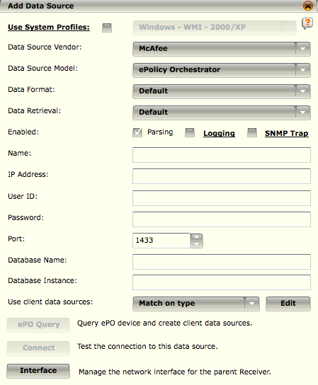
McAfee ePO
McAfee ePO is fully integrated via a direct database connection
You can set up multiple McAfee ePO data sources all pointing to the same IP address with different names in the database name field
Notes:
When you select McAfee in the Vendor field and ePolicy Orchestrator (ePO) in the Model field, you can set up multiple McAfee ePO data sources all pointing to the same IP address with different names in the database name field. This allows you to set up as many ePO data sources as you choose and have them all point to a different database on your central server.
Name – Name which the data source will show as in the tree and for reporting options.
IP Address – IP Address of the ePO server.
User ID / Password – Credentials granting access to the ePO database.
Port – SQL Server port
Database Name – Name of the ePO database
Database Instance – If multiple database instances are running on a single server, the name of the instance you wish to connect to.
Client Data Sources – Mandatory option to separate installed products into individual data streams.
ePO Query – Queries the ePO database to create the client data sources.
Connect – Test the connection to the ePO database.

Slide 32
Client Data Sources count against the maximum allowed data sources per receiver?
True
False
Notes:
FALSE: Client Data Sources do not count against the maximum allowed data sources per receiver.

Slide 33
Data source profiles can be accessed via the ___________?
Enterprise Security Manager (ESM) Properties
Receiver Properties
Add Data Source Properties
Add Client Data Source Settings
Notes:
Answer: Enterprise Security Manager (ESM) Properties

Slide 34
What can Vulnerability Assessment data sources be used to do within the McAfee SIEM?
Notes:
Answer:
VA data can be used for the following:
Raise an event’s severity based on knowledge of the end point’s known vulnerability to that event
Automatically learn assets and their attributes (OS and services detected)
Provide a mechanism to define Asset Filter Groups and allow you to create and manipulate the membership of user-defined Asset Groups
Provide summary and drill-down information of the network assets
Modify Policy Editor configuration (i.e., turn on MySQL signatures if an asset is discovered to be running MySQL).

Slide 35
Hands-on Practice Refer to the Practice Manual Practice 4: Data Sources

